Slide 1
HAPPY 2 22!!!
Join the YUFERING project’s journey to Open Science
Cover photo: Nicolaus Copernicus University Library (CC BY 4.0)

Slide 2
If science is not open… it is not going to help us
Open Science and Open Knowledge accelerate research and advance to face social challenges (COVID pandemic, SDGs).
The European Commission and many other political and scientific institutions, as well as research funding agencies, promote the urgent implementation of Open Science.
Image adapted from goodfreephotos.com (CC0)
PUT YOUR LOGO HERE

Slide 3
YUFE researchers are committed to good practices in Responsible Research and Innovation (RRI) and are going to be particularly engaged this year with Open Science
Start this journey with a reflection every month to become an Open Scientist.
4-5: Paris Open Science European Conference (OSEC).
Image adapted from @eimearmcnally
PUT YOUR LOGO HERE

Slide 4
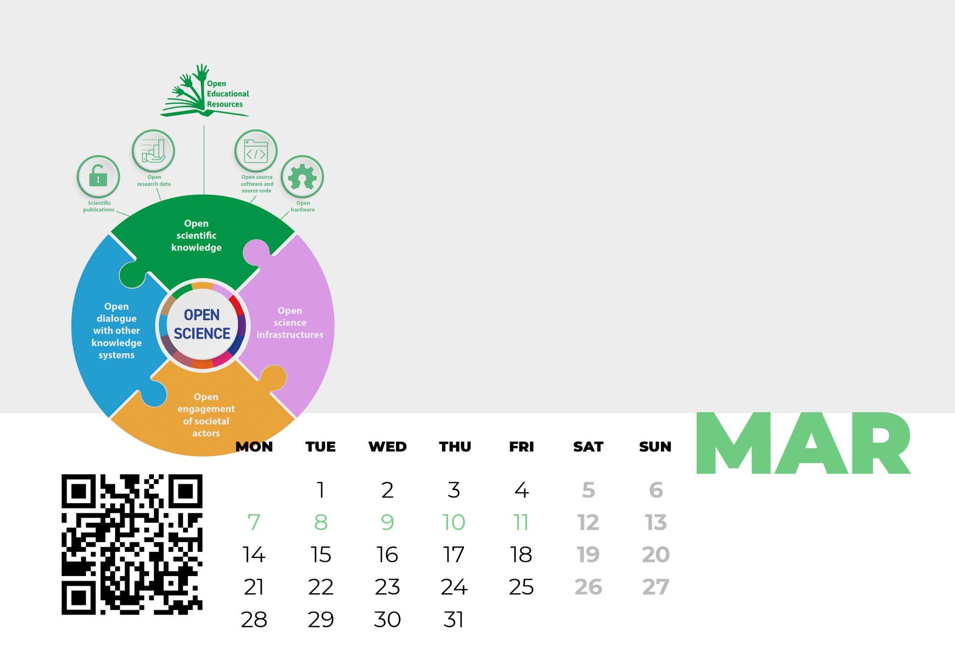
Open education is a way to democratise research and education, adding a positive value to the knowledge created at Universities
7-11 March: Open Education Week. Join this annual celebration as an opportunity to learn about the latest achievements in Open Education worldwide.
Image adapted from the UNESCO Recommendation on Open Science, p. 11 (CC BY 3.0 IGO)

Slide 5
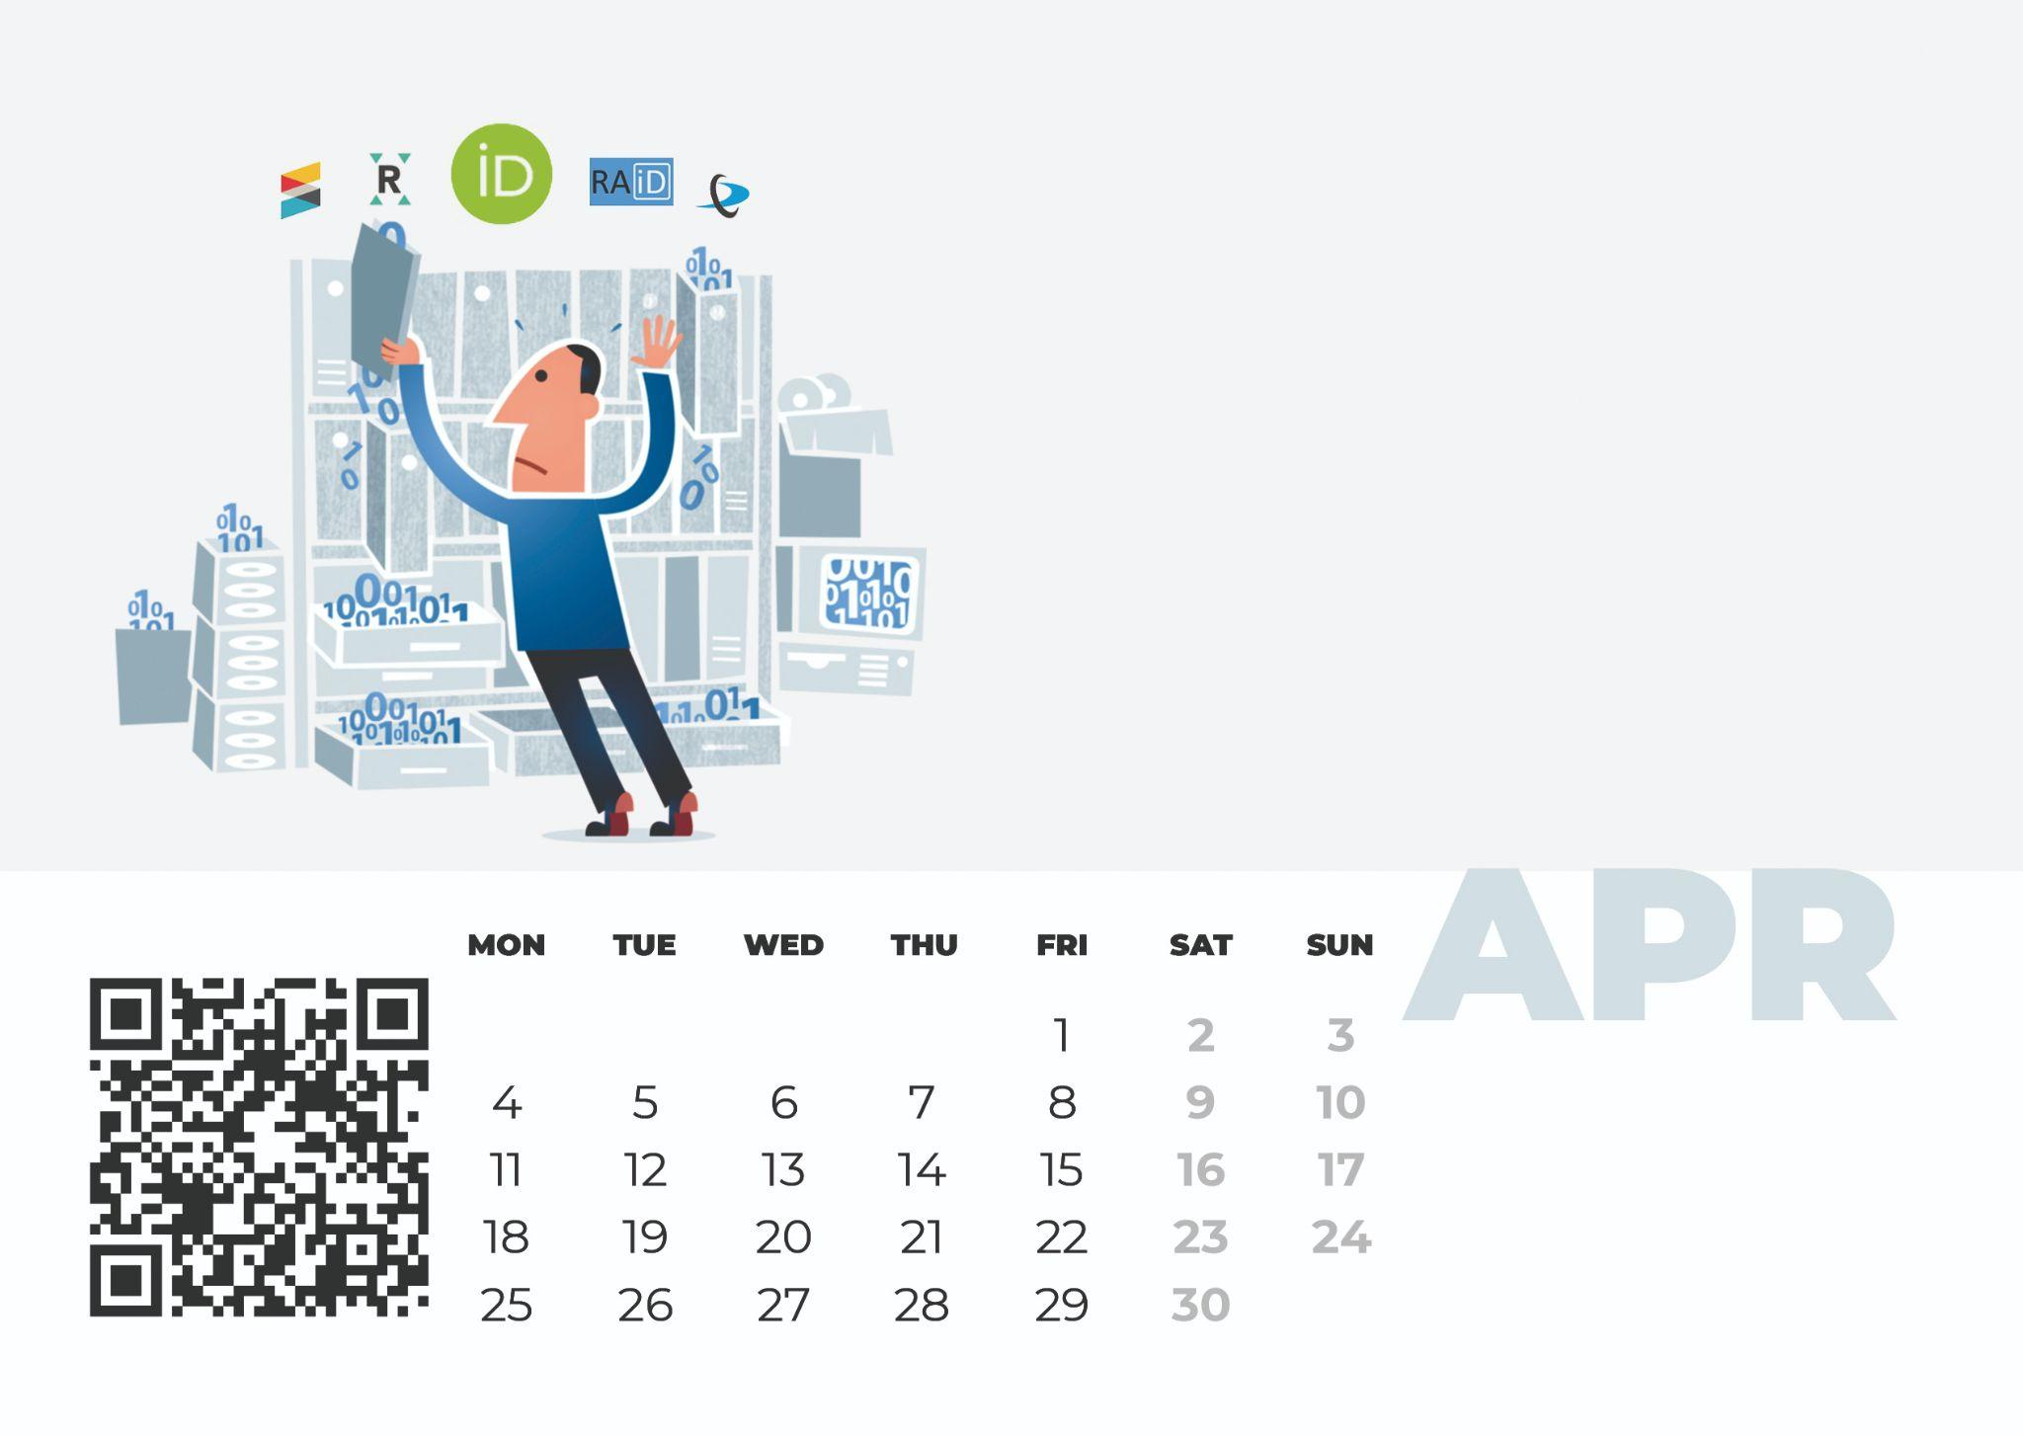
Persistent identifiers are the enablers for building trust and support openness in the digital era
Create/Update your ORCID profile orcid.org and remember that the name of your institution is ’ Nicolaus Copernicus University’ or ‘Uniwersytet Mikołaja Kopernika w Toruniu’ https://ror.org/0102mm775
Image adapted from Jørgen Stamp CC BY 2.5 Denmark licence digitalbevaring.dk

Slide 6
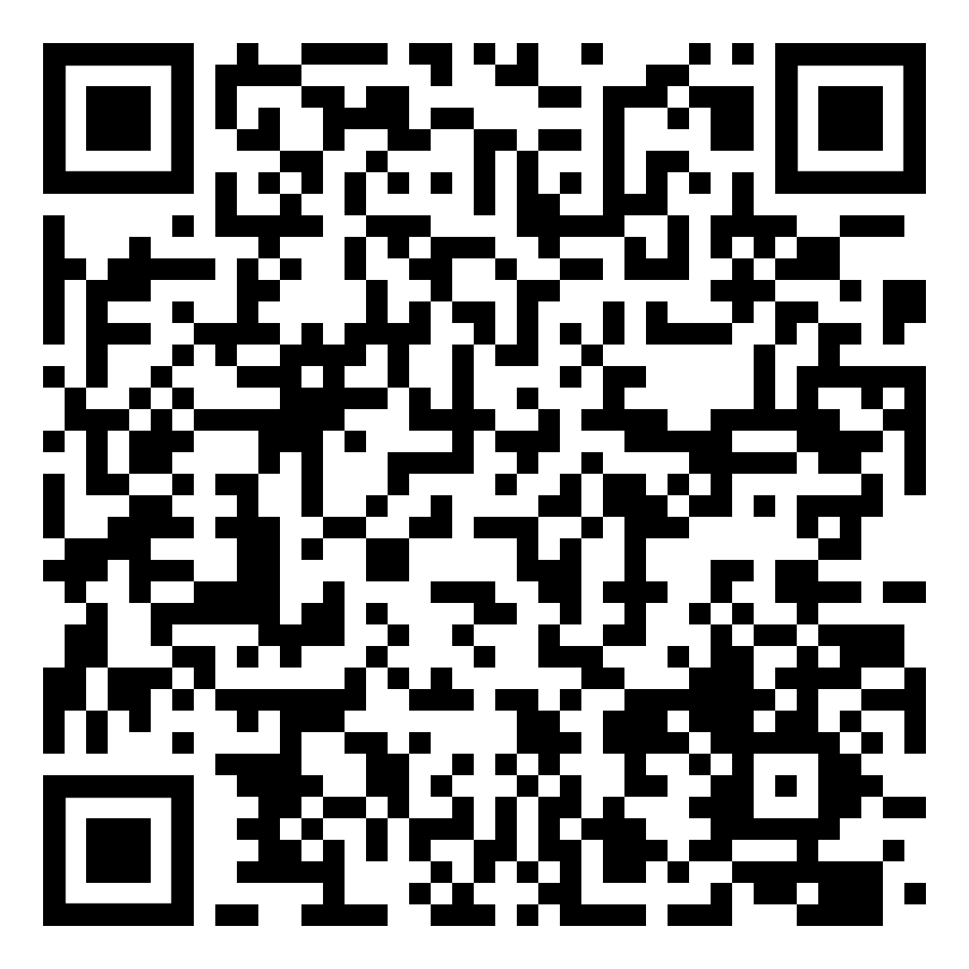
Open Science practices are increasingly included and rewarded in the research assessment
Become a Full Open Science (FOS) researcher: your university supports you.
Image adapted (CC0 Public Domain)

Slide 7
Open Science is a must for all researchers. It is preferable to learn these skills in early research stages
Have you done any training in Open Science this year? Become a SOS (Supervisor in Open Science) for your PhD students.
Universidad Carlos III de Madrid (CC BY-NC-SA 2.0)
PUT YOUR LOGO HERE

Slide 8
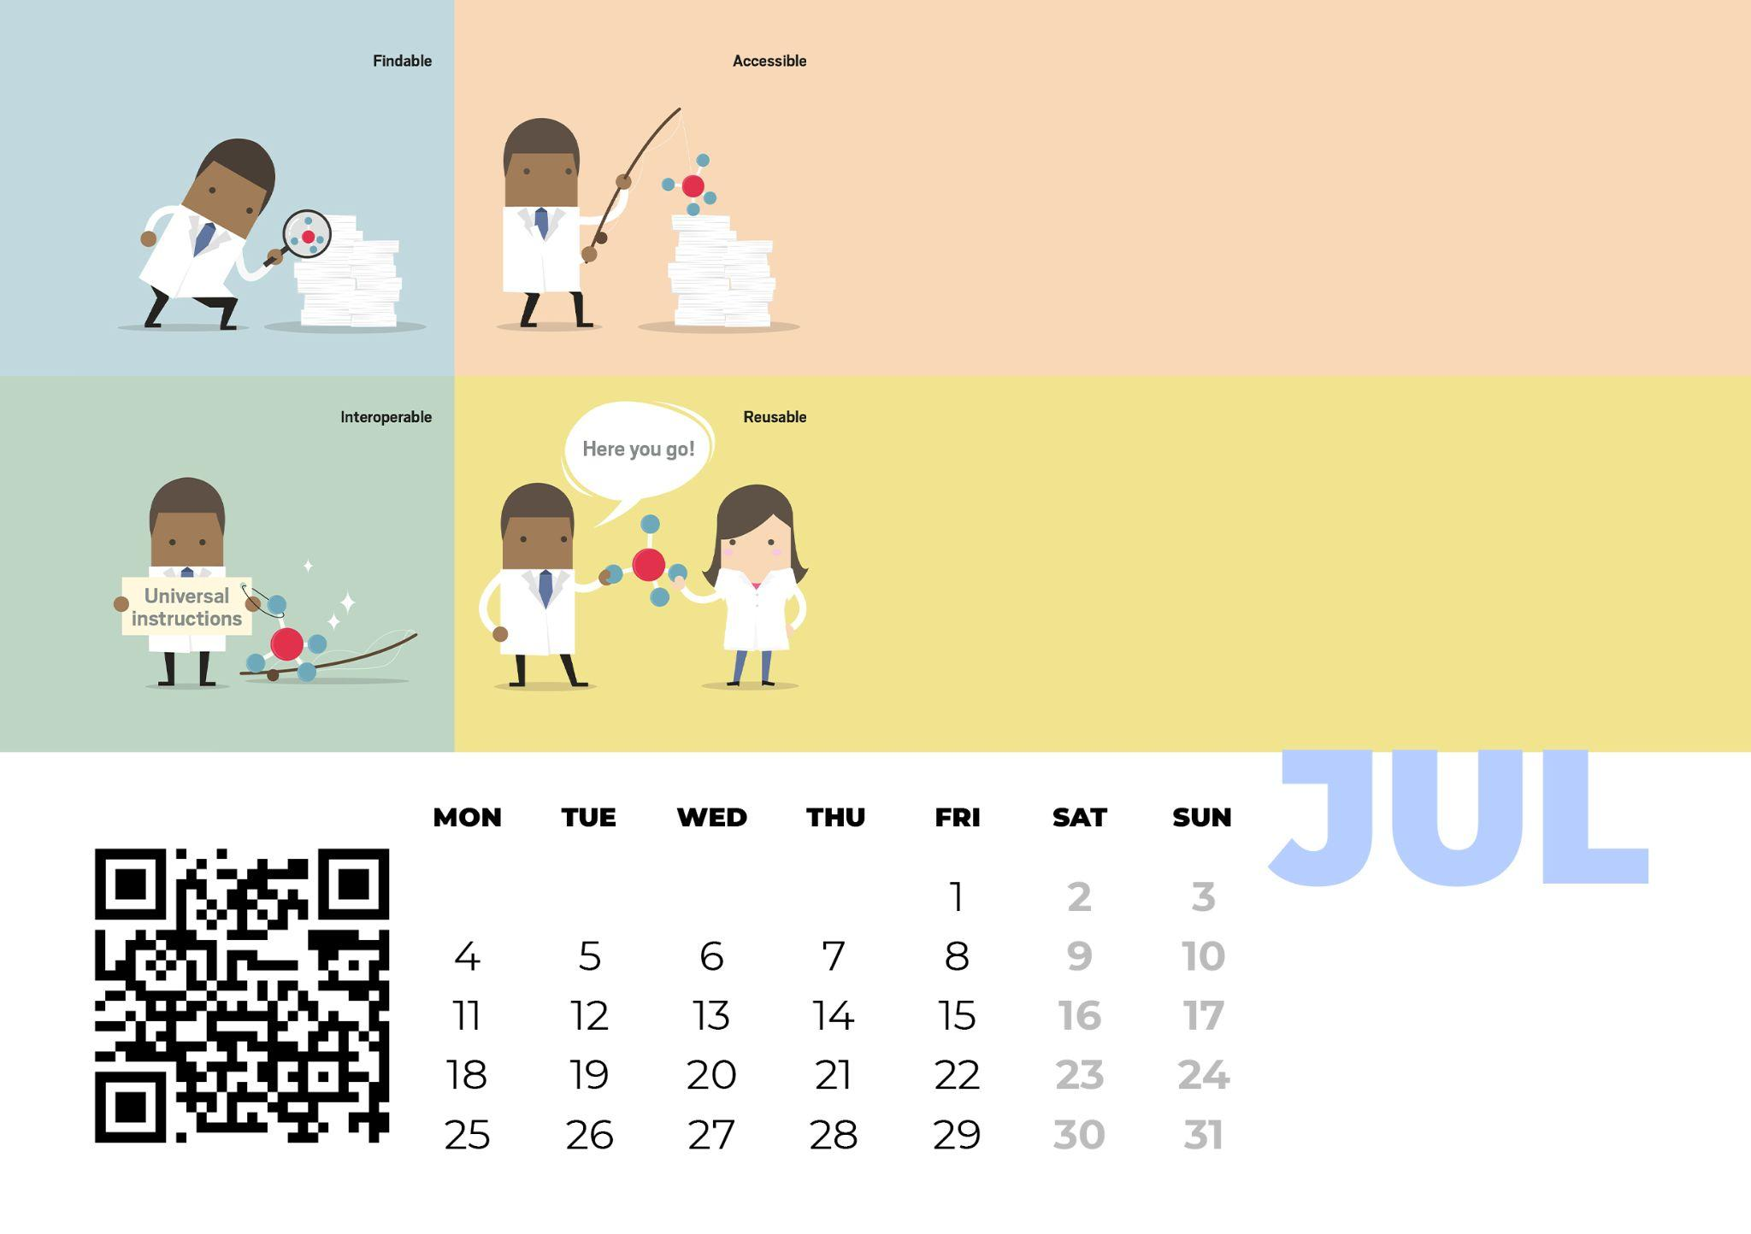
The reproducibility and integrity of the research are essential principles of any scientific study
Sharing and storing research data and making them FAIR (Findable, Accessible, Interoperable and Reusable) allows new discoveries, new collaborations and the verification of results and the reproducibility of studies. Share your data whenever possible!
Image adapted from Yang H. Ku / C&EN / Shutterstock

Slide 9
Open science is a shift that entails the move from ‘publishing as fast as possible’ to ‘sharing knowledge as early as possible’
Switch your mind!
Start thinking about Open Science practices in your workflow when writing your next grant proposal. Think about opening your publications, data, software, protocols, and methodologies in new eResearch collaborative spaces.
Image adapted (CC0 Public Domain)

Slide 10
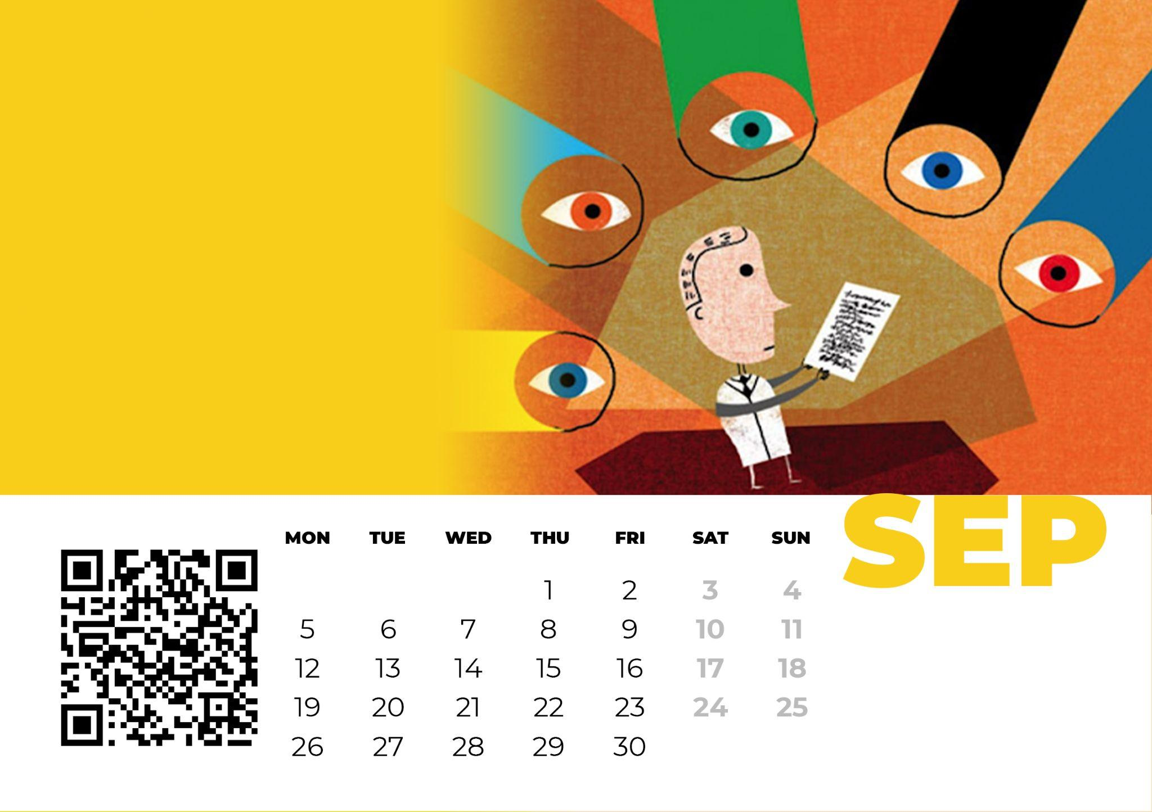
Openness is a clear invitation to quality, rigor and transparency
Open peer review implies greater responsibility and is based on trust and respect and promotes good Open Science practices, such as collaboration and recognition.
Find out how open peer review works in ORE (open-research-europe.ec.europa.eu), EC open access publishing platform.
AJ Cann (CC BY-SA)

Slide 11
Open access to publications (OA) remains a core element of Open Science
Join the Open Access week. Always upload your publications to the institutional repository and retain your rights as long as you publish in scientific publishers with a subscription model. Ask, reflect and open your publications as soon as possible. See: v2.sherpa.ac.uk
Hilda Bastian (CC-BY-NC-ND 2.0)

Slide 12
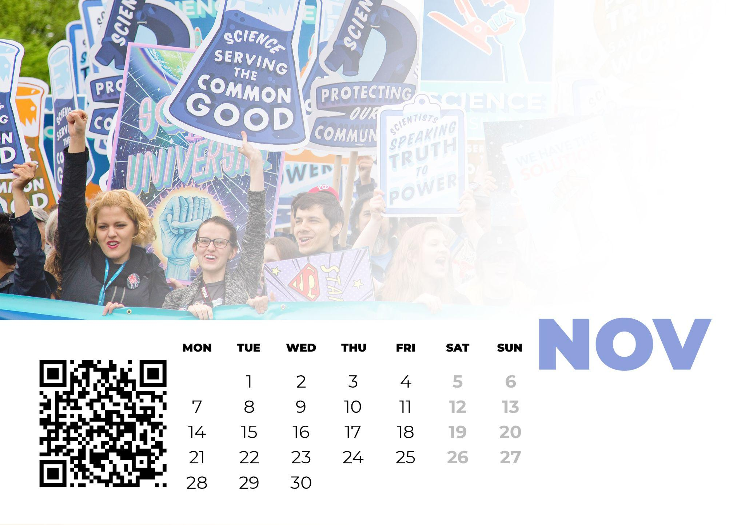
Today more than ever we must do science with and for society
Citizen science is both an objective and a facilitator of Open Science and a fundamental component in the new European Research Area (ERA).
Try including societal groups (citizens, organizations) in your research and discover their potential.
Image by Vlad Tchompalov (CC0) from Unsplash

Slide 13
Open Science enables a healthier research environment and helps researchers promote their work
Think about the most important things that you have achieved or learned in Open Science and reflect on where you go next. Create a to-do-list for the year 2023 to keep improving your Open Science performance. If you still have any doubt?
Image by Marina Sánchez Moreno ( CC-BY 4.0)
https://www.bu.umk.pl/open-access
ask-open-science.org

